Slide 1
UN Declaration on the Rights of Indigenous Peoples
Truth and Reconciliation Week 2023

Slide 2
Discussion Questions
How does the doctrine of discovery apply in your province or territory (on what basis does the government assert they have sovereignty)?
What can you say to people who express concern about implementing the UN Declaration on the Rights of Indigenous Peoples?
What is one thing you can do to promote implementation of the UN Declaration on the Rights of Indigenous Peoples?
How can all of Canada benefit from the implementation of Indigenous peoples’ laws?

Slide 3
Resources (online resources, books, films)
Text of UN Declaration on the Rights of Indigenous Peoples: https://social.desa.un.org/issues/indigenous-peoples/united-nations-declaration-on-the-rights-of-indigenous-peoples.
Handbook on the UN Declaration: https://chrr.info/wp-content/uploads/2015/10/UNDRIP_Handbook_WEB.pdf.
Understanding UNDRIP & Bill C-15: Warrior Life Podcast: https://www.youtube.com/watch?v=VuWtRmGIrro.
Indigenous Law Research Unit resources, Uvic: https://ilru.ca/resources-2/.
John Borrows, “Canada’s Indigenous Constitution” (2010).
Canada’s Action Plan: https://www.justice.gc.ca/eng/declaration/ap-pa/index.html.

Slide 4

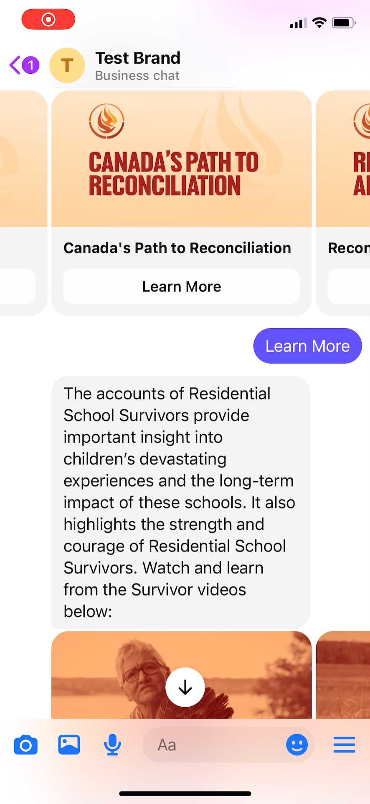

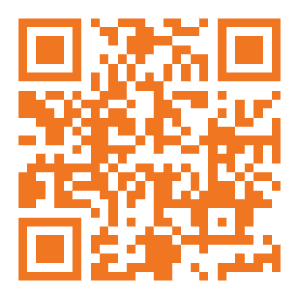

Reconciliation begins with education
Learn more about the truths of residential schools & the path to reconciliation, all through an interactive Messenger experience.
Scan the QR code now!

Slide 5
THANK YOU FOR JOINING US!!!
Day 5 – Sept. 29: Taking action towards Reconciliation
  Speakers: Jimmy Durocher, Dale LeClair
For more information about the National Centre for Truth and Reconciliation, please see our website: nctr.ca
Donations to support our education work are graciously accepted through our website.

